Slide 1
TelCo Customer Churn Prediction
Devanshu Khurma (260894480)
Jiajun Huang ( 260629217)
Charlie Cai (...)
Evelyn Sun (260915480)

Slide 2
Problem Definition
& Core Tasks
Problem Definition
1
Predicting (i.e., classifying) whether a current customer will churn from TelCo or not
7043-observation (customer) with 19 predictors dataset
2
Benefits
Marketing and Customer Retention team - Model Prediction
Higher-Level Managers - Interpretability Report
3
Core Tasks
Trained multiple Python-based Machine Learning models
Programmed a H20.ai-based Auto Machine Learning model
Tested causal inference on binary predictors such as: gender, SeniorCitizen, Partner, Dependents, PhoneService, and PaperlessBilling
Assembled a model interpretability and explainability analysis using SHAP package
Composed a Machine Learning Bias Report based on the SHAR analysis
4
Other Considerations
Run offline periodically (at most once a day)
Batch processing system using Apache Spark
Notes:
1.5 mins

Slide 3
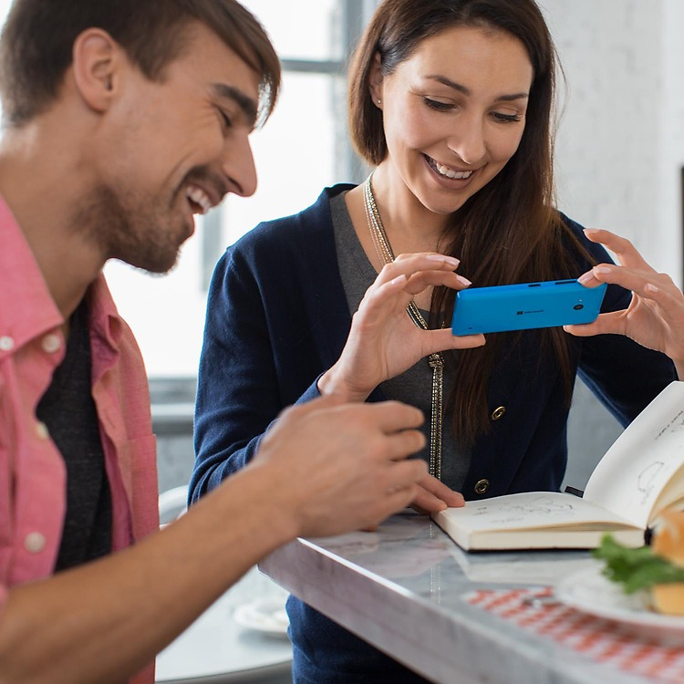
Python Based Model
Model | Accuracy Score | F1 Score
KNN | 0.772903 | 0.564356
Decision Tree | 0.792688 | 0.541825
Random Forest | 0.792688 | 0.560219
Logistic Regression | 0.80086 | 0.59135
XG Boost | 0.807742 | 0.588018

Slide 4
H2O AtuoML
H2O’s AutoML can be used for automating the machine learning workflow, which includes automatic training and tuning of many models within a user-specified time-limit. It has made it easy for non-experts to experiment with machine learning to set a benchmark.
10 Best Performing Models Selected by H2O AutoML
H2O AutoML Model Results
model_id | auc | mse
StackedEnsemble_BestOfFamily_AutoML_20200216_115946 | 0.850544 | 0.133636
StackedEnsemble_AllModels_AutoML_20200216_115946 | 0.850509 | 0.133678
GBM_5_AutoML_20200216_115946 | 0.848467 | 0.13321
GLM_1_AutoML_20200216_115946 | 0.847801 | 0.133984
GBM_grid__1_AutoML_20200216_115946_model_1 | 0.842607 | 0.148619
GBM_1_AutoML_20200216_115946 | 0.841779 | 0.136873
GBM_2_AutoML_20200216_115946 | 0.841048 | 0.136614
GBM_3_AutoML_20200216_115946 | 0.838457 | 0.138417
DeepLearning_1_AutoML_20200216_115946 | 0.83469 | 0.13864
GBM_4_AutoML_20200216_115946 | 0.832629 | 0.140648
XRT_1_AutoML_20200216_115946 | 0.832395 | 0.140071
DRF_1_AutoML_20200216_115946 | 0.828687 | 0.141467
Model | Accuracy Score | F1 Score
Random Forest | 0.8272 | 0.6308
Gradient Boosting | 0.8346 | 0.6272
Neutral Network | 0.8257 | 0.6193

Slide 5
Model Results Comparison
H2O AutoML generates better accuracy score
H2O AutoML generates better F1 score
In general, Random Forest and Gradient Boosting from H2O AutoML deliver better performance

Slide 6
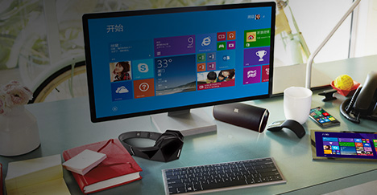
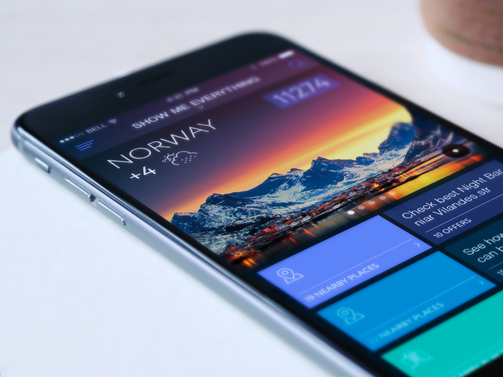
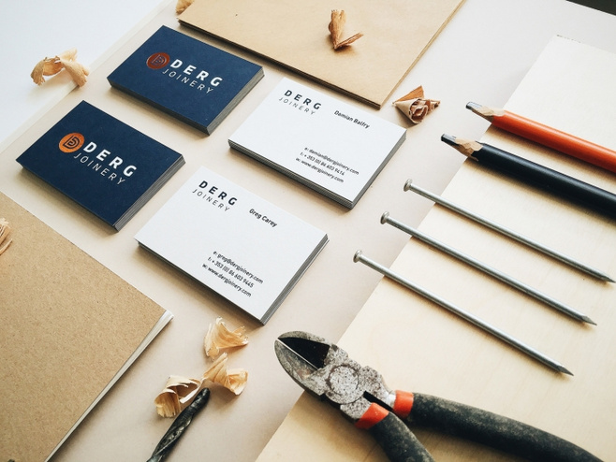
Causal Inference - Charlie
ADD YOUR TITLE
ADD YOUR TITLE
ADD YOUR TITLE

Slide 7
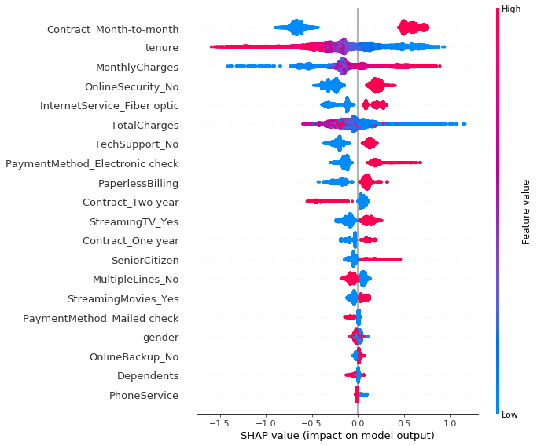
Model Interpretability and Explainability
Notes:
1 mins

Slide 8
Conclusion
3
2
1
Next Step
Action Recommended
Marketing campaign and offers based on model interpretability report and causal inference
Find the unobserved variables
Model Bias Report
Drop: Gender
Keep: partner, dependents, senior citizen
Gender,
Senior citizen (i.E., Whether the customer is a senior citizen or not),
Partner (i.E., Whether the customer has a partner or not)
Dependents
Notes:
- 1 mins

Slide 9
THANK YOU

